Slide 1

Multi Threading
Abdelrahman Mohamed

Slide 2



Agenda
Introduction
Why Use Multithreading?
Advantages of Multithreading
Disadvantages of Multithreading
Mutex solution
Conclusion

Slide 3




Introduction
Multithreading is like having a team working on different tasks at the same time. It’s a way for your computer to do multiple things at once, which can make your programs run faster and be more responsive.
However, it’s not really “at the same time” on a single-core processor. It’s more like a fast switch between tasks, which gives the illusion of simultaneous execution. This is kind of useful because it can make your computer feel faster and more responsive.

Slide 4

Why We Use Multithreading?
Multithreading is used to achieve concurrency within a single process.
It allows us to run multiple functions in our program concurrently, especially on multiple cores.
This leads to greater resource sharing, faster execution, and improved responsiveness.

Slide 5
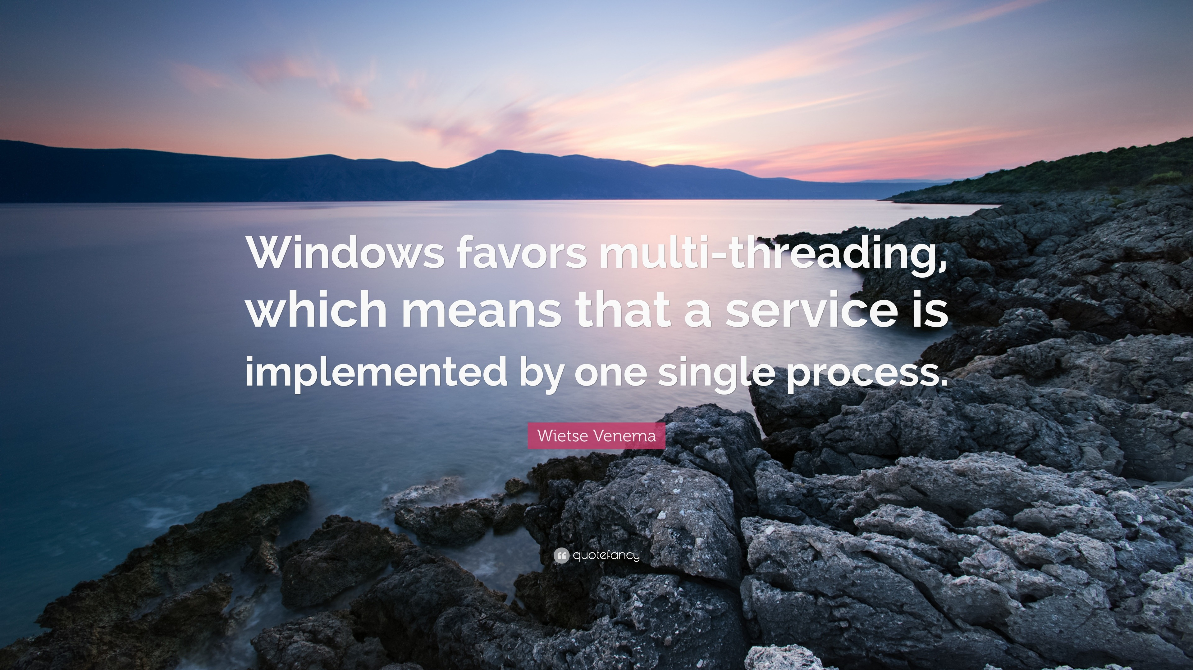
Multi Threading
In terms of performance, there are studies showing that Ubuntu 19.04 is currently better than the Windows 10 May 2019 Update with a difference of around 8%.
However, the performance can vary depending on the specific workload, hardware, and other factors3.

Slide 6
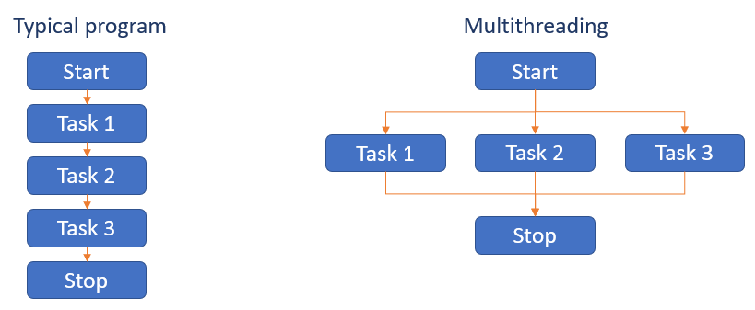
Advantages of Multithreading
Responsiveness: Multithreading in an interactive application may allow a program to continue running even if a part of it is blocked or is performing a lengthy operation.
Resource Sharing: Threads share the memory and the resources of the process to which they belong by default.
Economy: Allocating memory and resources for process creation is a costly job in terms of time and space. Since threads share memory with the process they belong to, it is more economical to create and context switch threads.
Scalability: The benefits of multi-programming greatly increase in case of multiprocessor architecture, where threads may be running parallel on multiple processors.

Slide 7

Disadvantages of Multithreading
Complex Debugging: Finding and fixing bugs can be tough because multiple threads may be running at the same time, causing unexpected issues.
Higher Resource Consumption: Using more threads can lead to using more of the computer’s memory and processing power.
Increased Synchronization Complexity: Making sure threads work well together without messing up each other’s tasks can be tricky and requires careful planning.
Potential for Thread Interference: Threads can step on each other’s toes, leading to mistakes if they try to change the same data at the same time.

Slide 8

Mutex Solution
A mutex (short for “mutual exclusion”) is a programming concept that is frequently used to solve multi-threading problems.
It provides mutual exclusion, either producer or consumer can have the key (mutex) and proceed with their work.
Each thread needs to lock a mutex before modifying or reading the shared data and after modifying the data each thread should unlock the mutex.

Slide 9

Summary
Multithreading is a powerful tool in modern computing, allowing for increased efficiency and performance.
However, it also introduces complexity and potential issues that need to be carefully managed. Tools like mutexes can help manage these complexities, but careful design and implementation are crucial for effective multithreading.

Slide 10


Thank You
Abdelrahman Mohamed

